Slide 1
An Unexpected Benefit
Student’s Name
Institutional Affiliations
Notes:
This presentation provides a summary of the article “An Unexpected Benefit.”

Slide 2
Introduction
The emergence of COVID impacted health providers and insurers
Health insurers were not financially affected by the pandemic
Health providers with no health plan were affected significantly
Patient revenue reduced while health plan premium income remained gradually
The pandemic has not influenced providers to implement health plans
Notes:
As the article's title states the “An unexpected benefit," many healthcare providers who had implemented health plans have benefited a lot. Therefore, with the emergence of coronavirus, the government regulations on stopping any nonurgent health procedures resulted in decreased patient revenues. However, providers such as Presbyterian healthcare that had health plans gained a lot since premium plans were stable. Similarly, health insurers did not have any financial damage because of the constant premium revenues and low claims. Although hospitals and physician clinics had learned a good lesson for working with fee-for-service, they are not yet influenced to implement the program because it is challenging, and only more prominent players will benefit.

Slide 3
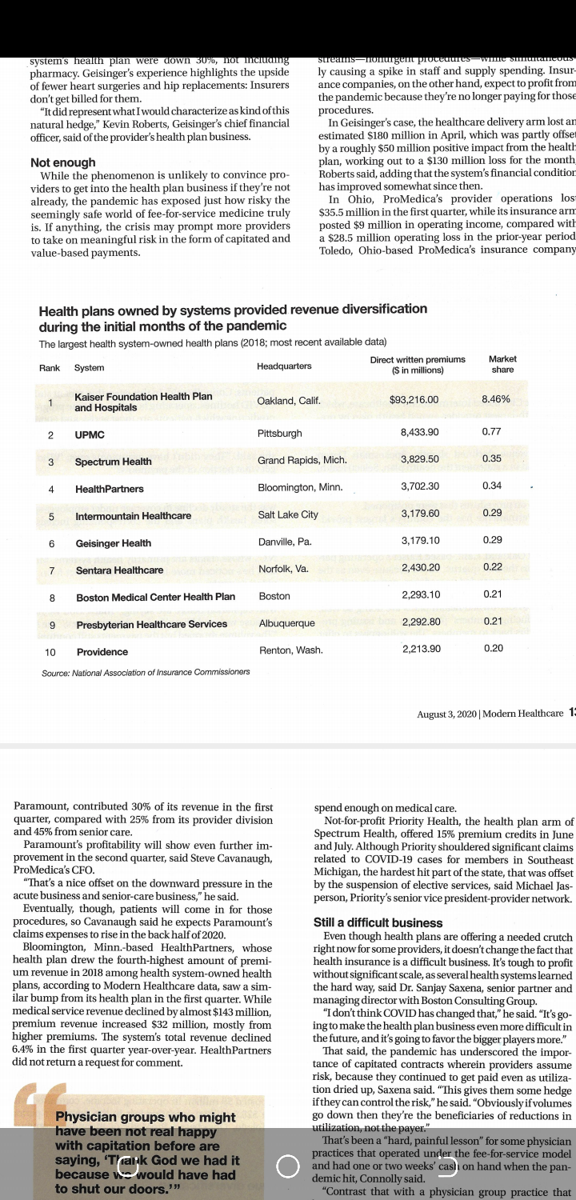
Not Enough
Providers that have suffered extreme losses are hospitals and physician clinics depending on free-for-service
The top ten health systems with health plans have indicated a significant increase in revenue (Bannow, 2020)
The free-for-service system is riskier during the pandemic than the capitated system
The pandemic has not influenced providers to start health plans if they had not started already
Capitation system has more advantages because it avoids unnecessary tests and procedures
Notes:
The coronavirus pandemic resulted in several impacts on the health systems, making some hospitals and physician clinics suffer financial losses due to reduced patient revenues. However, the providers who have implemented health plans have encountered a good experience since premium plans remained stable while claims were reduced. Free-for-service systems require patients to go to healthcare providers to be assessed and treated and pay for the services. However, the capitated system is where the provider is paid a fixed amount per patient for an agreed amount of time by the insurer. HealthPartners is the fourth provider offering health plans and indicated that the therapeutic service profits reduced with nearly 143 million dollars while premium incomes intensified by thirty-two million dollars (Bannow, 2020). Thus, although the pandemic has shown a challenge, it has not influenced providers to invest in the business if they had not been involved in it. Moreover, Americans have been disappointed by free-for-service and are better with capitation because it evades unnecessary tests and procedures hence better care.

Slide 4
Still a Difficult Business
Despite the pandemic indicating the risky of fee-for-service, a health plan is still a challenging business (Bannow, 2020)
The pandemic has not changed anything as it has led to more challenges in future
Coronavirus has accentuated the significance of capitated agreements
There is a sturdy decrease in coverage under employer-sponsored health plans leading to more stress on the capitated system
Notes:
While the pandemic provided a clear reflection on the benefits of having a capitated system than a fee-for-service system, it has not influenced providers to implement the health plans in their care. Nonetheless, the health plan implementation is challenging, especially to those healthcare institutions which had not implemented the system before the pandemic (Bannow, 2020). Similarly, the pandemic has not altered anything because it will lead to the increased complexity of entering the health plan business since the major players will be favored. Nonetheless, the coronavirus has accentuated the significance of capitated agreements since healthcare facility presumed risks as they receive payments as usage desiccated. Correspondingly, providers receive financial gains if they manage to control the risks. Nonetheless, the coronavirus disease has accentuated the capitated system since the steady decrease in coverage under the employer-sponsored health plans and the consistent intensification in Medicaid and Medicare treatment.

Slide 5
Benefits of Integrating Health Systems and Plans During Such A Crisis
Staffing crisis hotlines (Bannow, 2020)
Leading overreach to patients
Implementing healthcare at home plans
Forecasting individuals who are most at risk
Notes:
Health facilities with health plans can incorporate them into their health systems and help enhance patient care. For instance, they can easily employ more individuals to handle crisis outlines, such as in case a patient requires care; they can call the hospital and get services (Bannow, 2020). Moreover, they can lead overreach to patients through outreach programs; they can reach those patients who have no opportunity of accessing healthcare services. While the pandemic resulted in people being away from public gatherings, outreach programs would help provide the benefits to patients' location. Implementing healthcare at home programs will also be effective through the integration of the systems. Finally, the most important thing is identifying individuals who are at most risk and helping them as early as possible.

Slide 6
Conclusion
Many hospitals in the United States uses premium health plans
Physician clinics and hospitals use a fee-for-service system
The pandemic has benefited health insurers financially
Coronavirus disease has not influenced providers to involve in health plan business
Employer-sponsored health programs have reduced, and Medicare and Medicaid programs intensified
Notes:
The article has focused on how health systems with health plans have benefited during the pandemic in summation. Many healthcare providers in the United States have implemented premium health plans. However, hospitals and physician clinics with no health plans have faced severe closure risks due to reduced patient revenues. Moreover, physician clinics and hospitals use fee-for-service, which was affected when the pandemic cut off non-urgent procedures. Similarly, this allowed health insurers to benefit as claims reduced and premium income maintained. Despite the risk associated with fee-for-service, providers are not influenced to involve in health plan business because of the reduction in employer-sponsor health plans as well as an intensification of Medicare and Medicaid programs.

Slide 7
Reference
Bannow, T. (2020). An Unexpected Benefit. Modern Healthcare.

